Slide 1
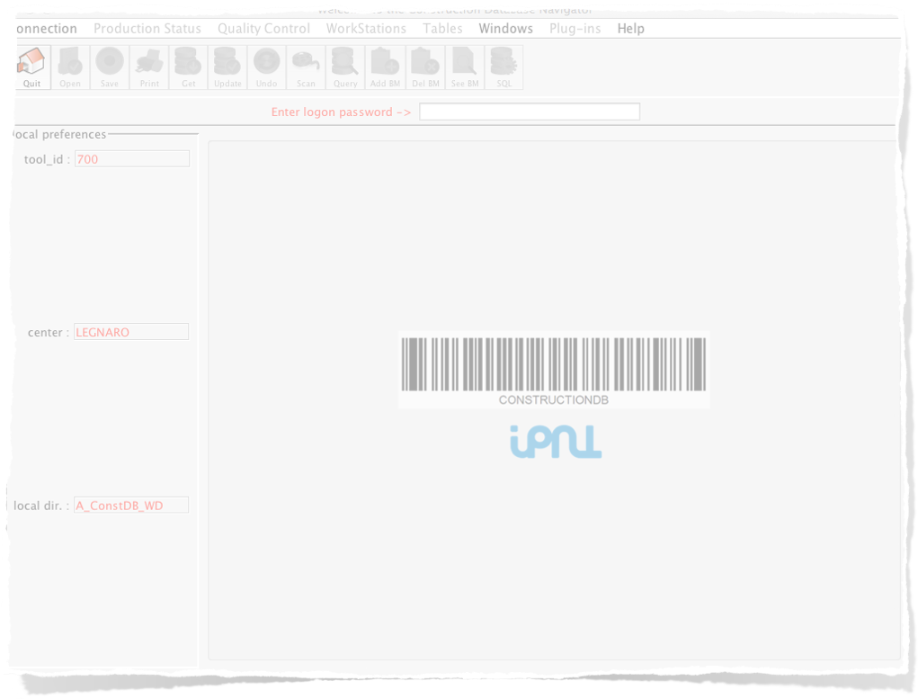



IPNL DataBase
Cookbook
Version 1
http://agata.in2p3.fr/DB

Slide 2
Legends
Mandatory Actions to get results
Optional Actions to have more precise informations
Some explanations
Not used anymore
http://links_to_similar_documentation

Slide 3
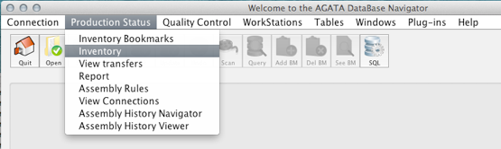
To Browse the Registered Objects
1. Select the Inventory
panel
or put (scan) a particular barcode
2. Query !
set filter on name, type, version of object(s)
you look for information
⎨
additional filters
by groups of obj.
by individual obj.
by individual + history
*** Careful ! ***
default is to show only
not assembled objects
Change here for more
⎨
Here is the result after Query
http://agata.in2p3.fr/VT/DB/index.html#InventoryPanel

Slide 4
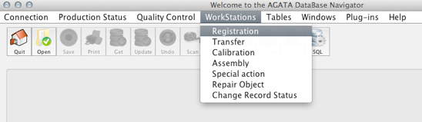
To add a new Object
1. Select the Registration
panel
2. Choose the
name - type - version
4. Update !
click if object is faulty
3. Put (scan) the barcode
sticked on it (enter)
check if center is ok
list of object
to be added
next time
Update (4.)
is called
⎨
http://agata.in2p3.fr/VT/DB/index.html#RegisterNewObject

Slide 5
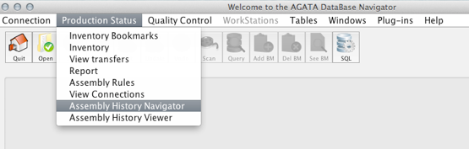
To Browse an Object that contains Objects
1. Select the
Assembly History Navigator
2. Put the object’s barcode
you search for the content [enter]
date status left side
compares the 2 dates
date status right side
Reference
to be compared with right
differences with left appear in red/bold
Move down in history
on right side
Move to first DB input
on right side
Move up in history
on right side
In case there are too many
objects to be displayed
Right panel becomes
left (i.e. reference)
Move to last DB input
on right side

Slide 6
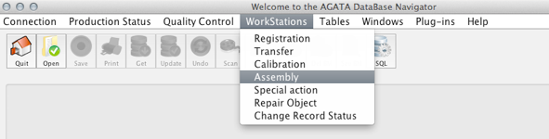
To change the composition of a composite object
1. Select the
Assembly panel
2. Add one card
3. Put the object to modify
4. Update !
sub-object to add/remove
click to remove otherwise added
Current
composition
⎨
click to add/remove components
http://agata.in2p3.fr/VT/DB/ChangeObjectComposition%20-%20Ordinateur.m4v

Slide 7
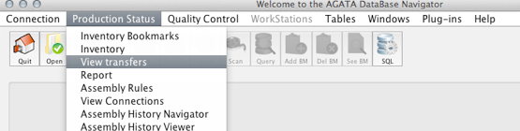
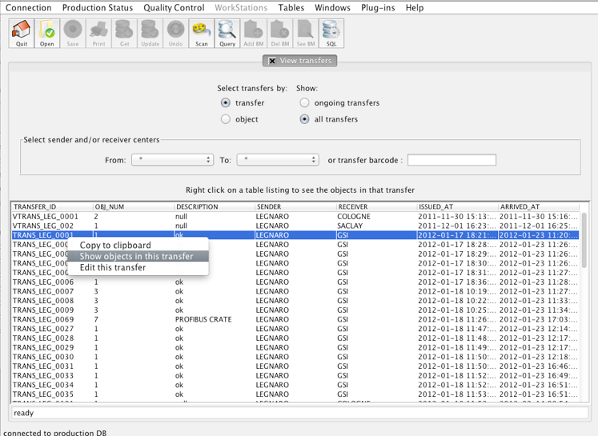
To Browse the Registered Transfers
1. Select the
View Transfers panel
2. Query !
or put (scan) a transfer barcode
additional filters
select source / destination
to look at the objects in the transfer
⎨
Here is the result after Query
http://agata.in2p3.fr/VT/DB/index.html#InventoryPanel

Slide 8
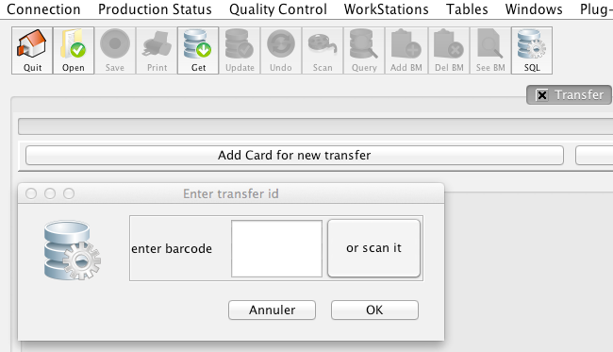
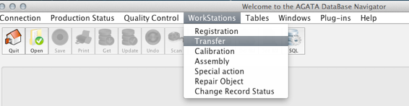
To initiate transfer Objects from one center to another one
1. Select the Transfer
panel
2. Add a new card
3. Enter a barcode
for the transfer
5. Close the transfer
4. Add all the objects to be transferred
(container enough for composite objects)
3. Select the destination
Add a comment
Not used anymore
⎨
list of object
added to the
transfer
http://agata.in2p3.fr/VT/DB/index.html#SendingObjects

Slide 9
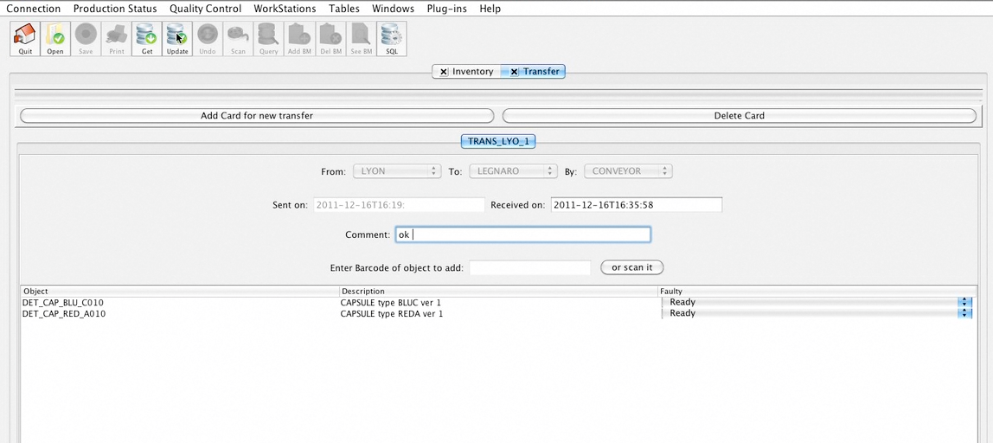
To Take Delivery of One Transfer
1. Select the Transfer
panel
3. Enter the barcode
of the transfer
2. Click on Get
4. Update
Add a comment
⎨
list of objects
inside the
box
http://agata.in2p3.fr/VT/DB/index.html#TakeDeliveryOfTransfert

Slide 10
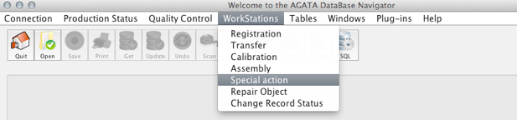
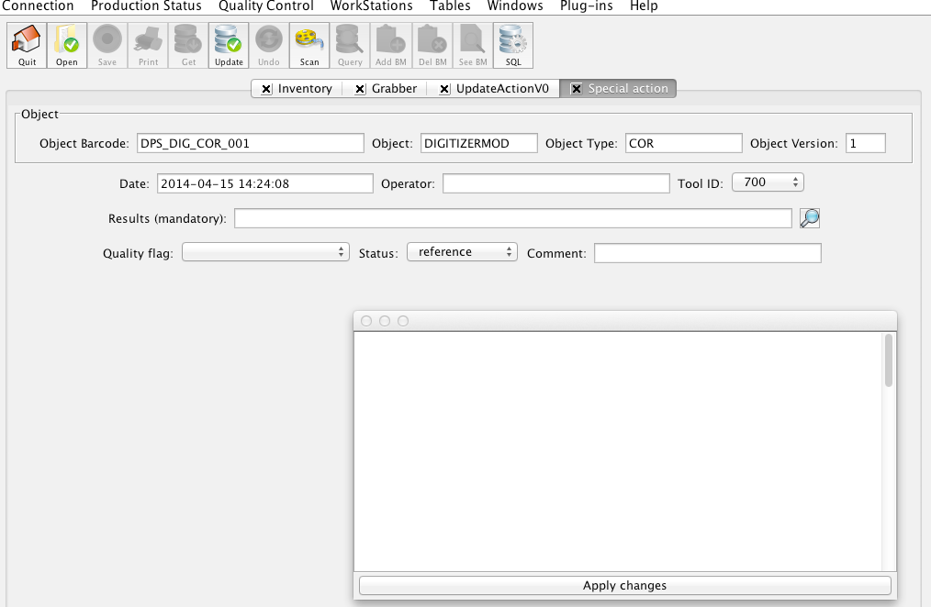


Special actions
1. Select the
Special action panel
5. Update !
give your name
2. set the object’s barcode
In this window\nI can write more \nthat one line with a maximum of 4000 cha
4. add an explanation
on one line
or
click on the loop for multi-lines
3. change if broken object
In this window
I can write more
that one line with a maximum of 4000 characters
http://agata.in2p3.fr/VT/DB/BrokenAndRepair%20-%20Ordinateur.m4v

Slide 11
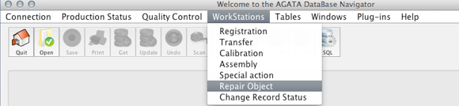
Repair actions
1. Select the
Repair Object panel
3. add an explanation
4. Update !
2. set the object’s barcode
give your name
http://agata.in2p3.fr/VT/DB/BrokenAndRepair%20-%20Ordinateur.m4v

Slide 12
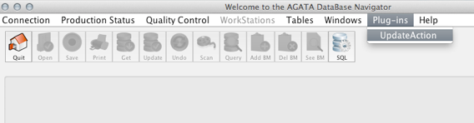
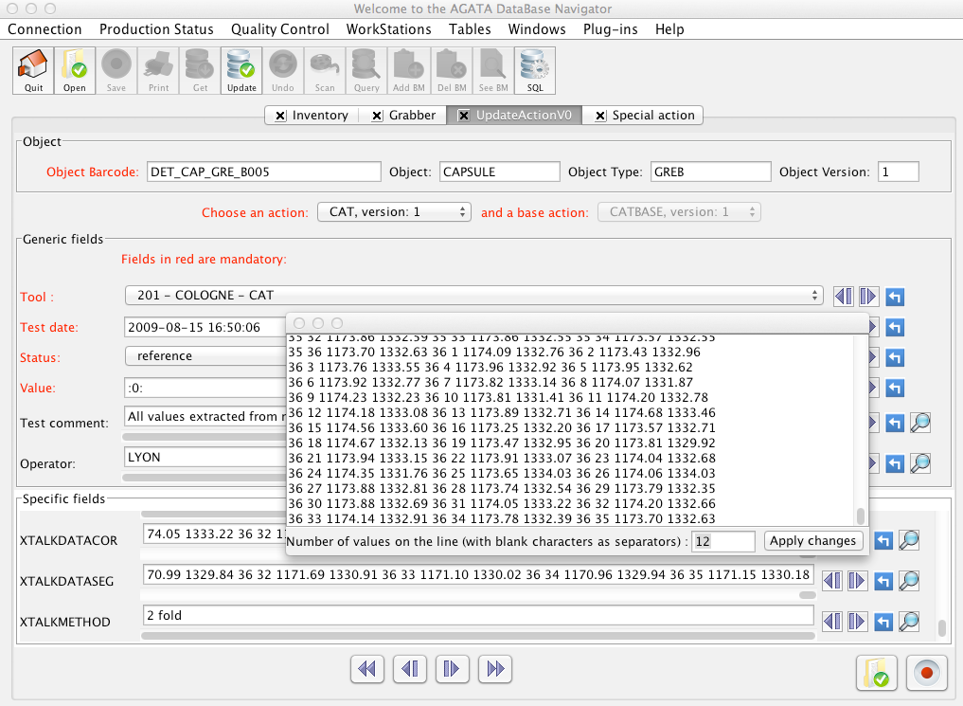
To add informations for a particular object
1. Select the UpdateAction
panel
2. Enter a barcode
4. Update !
set default
(current date for date)
move up in history
3. Select an action
move down in history
open box for big inputs
⎨
fill the
fields
Show # of columns
move all up to last input
apply changes
fill the
fields
⎨
move all up in history
Save data in a file
move all down in history
Load data from a file
move all down to first input

Slide 13
To add informations for a particular object
1. Select the UpdateAction
panel
2. Enter a barcode
4. Update !
set default
(current date for date)
3. Select an action
move up in history
move down in history
⎨
open box for big inputs
fill the
fields
# of columns
apply changes
fill the
fields
⎨
move all down in history
move all up in history
move all down to first input
move all up to last input

